Slide 1
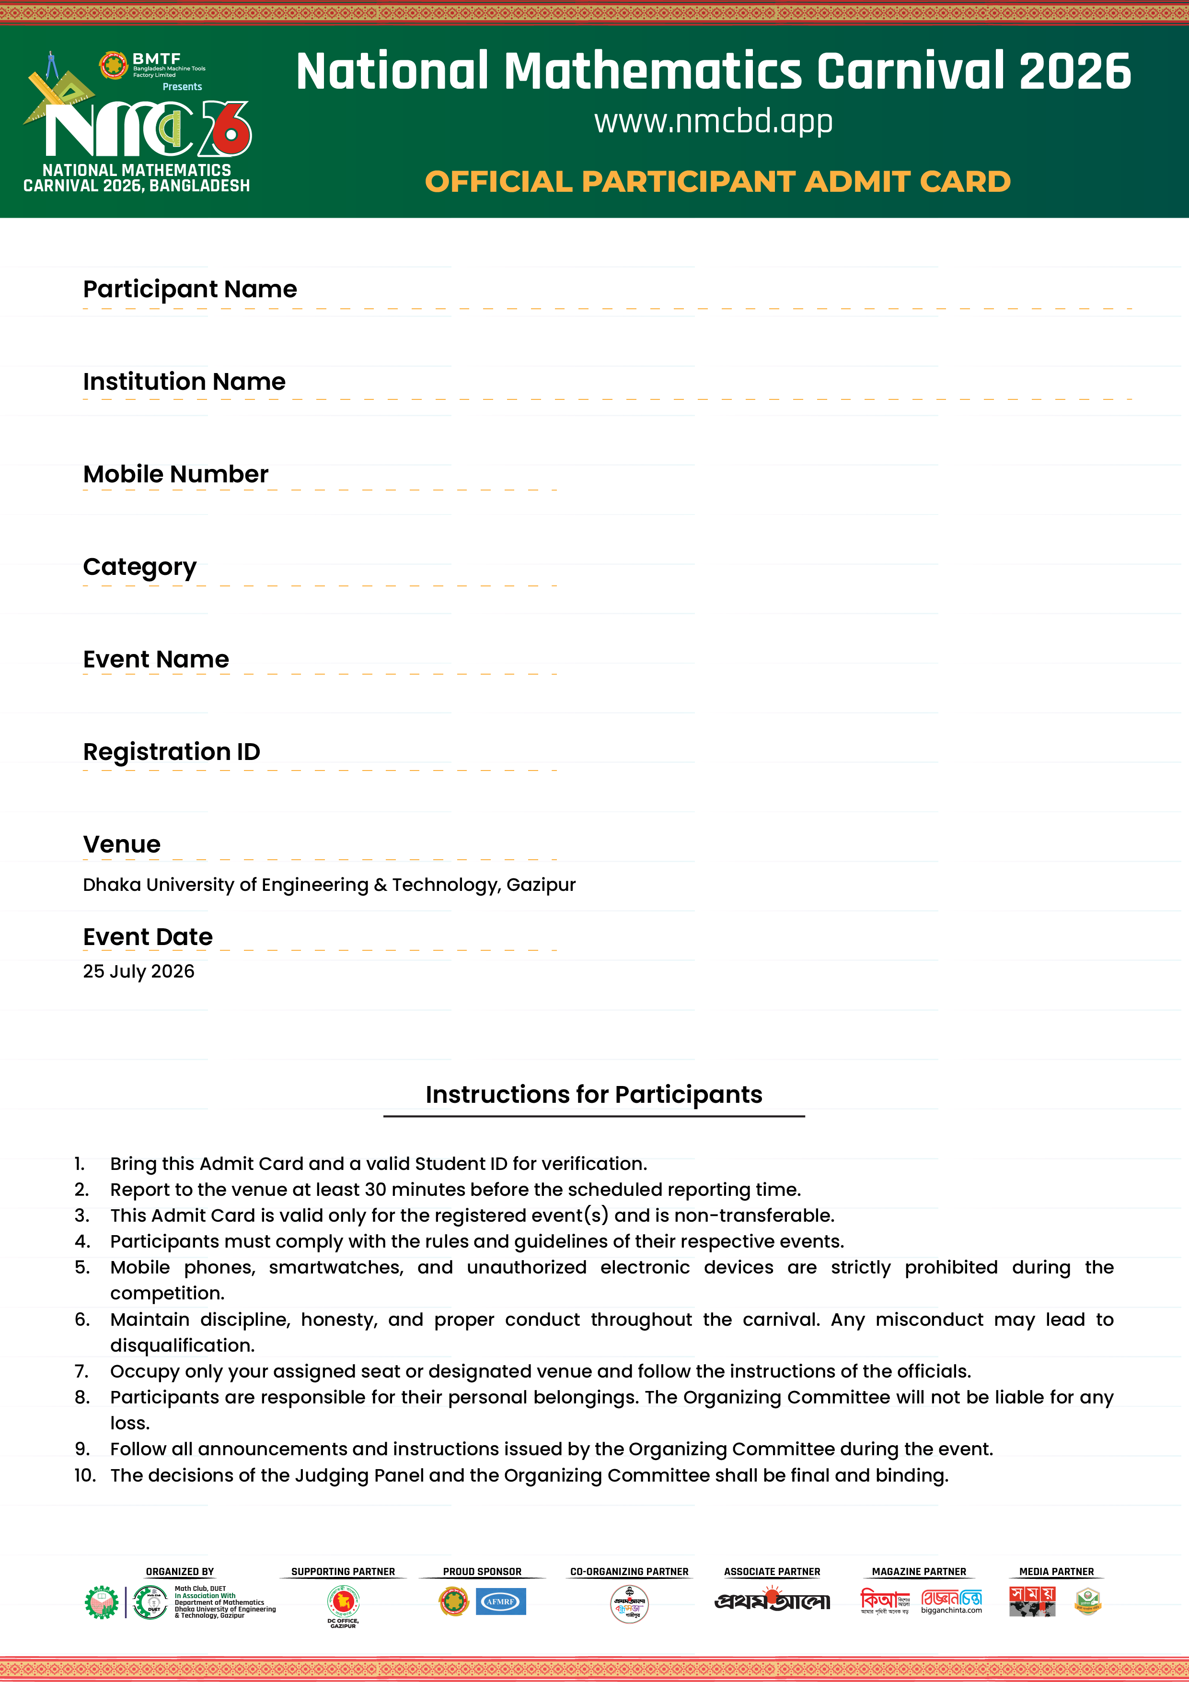
{{Name}}
{{Institution}}
{{Phone_Number}}
{{Participation_Level}}
{{Select_Event}}
{{qr}}
{{Serial}}

